Slide 1
Ticketmaster Rock Concert Analysis
Eva Murdock, Daniel Hill, Toby Guenthner, Alexa Hildebrand, Fernando Fonseca
Notes:
Alexa

Slide 2
Table of contents
01
03
02
04
Our data
Our analyses
Our process
Our conclusions
Notes:
Alexa

Slide 3
Our Data
Ticketmaster API
Event and sports information (filtered to rock shows)
Location, pricing, category, time
Re-structured API calling code → we have data on all rock concerts in the next 300 days
What affects rock concert ticket prices?
Notes:
Alexa

Slide 4
AWS CDK Process V2
Whole process (all 3 jobs, graph creation, website) refreshes daily at 4:00 am
Create glue workflow with 3 jobs
First job hits API and extracts data to S3 data bucket
Second job combines extracted data into combined_data.parquet
Third job processes combined_data.parquet into graphs
Graphs are referenced by index.html in data bucket
Deploy Live Website using S3 Static Website Hosting
Notes:
Daniel
Mention it is updating each day

Slide 5
Interactive Map!
Notes:
Eva

Slide 6
Our Investigations
Is there a cheaper day/time to watch Rock concerts?
Are tickets cheaper further out from the event?
What else affects concert ticket prices?
Notes:
Alexa
Something about we wanting to analyze if prices for events vary on different days of the week, for different types of events??...
So from there we were interested in deciding what days of the week are the cheapest and less competitive days to find tickets days with a really high max might indicate more interest in the game based on supply demand prices would go up. And then proceed to our analysis

Slide 7
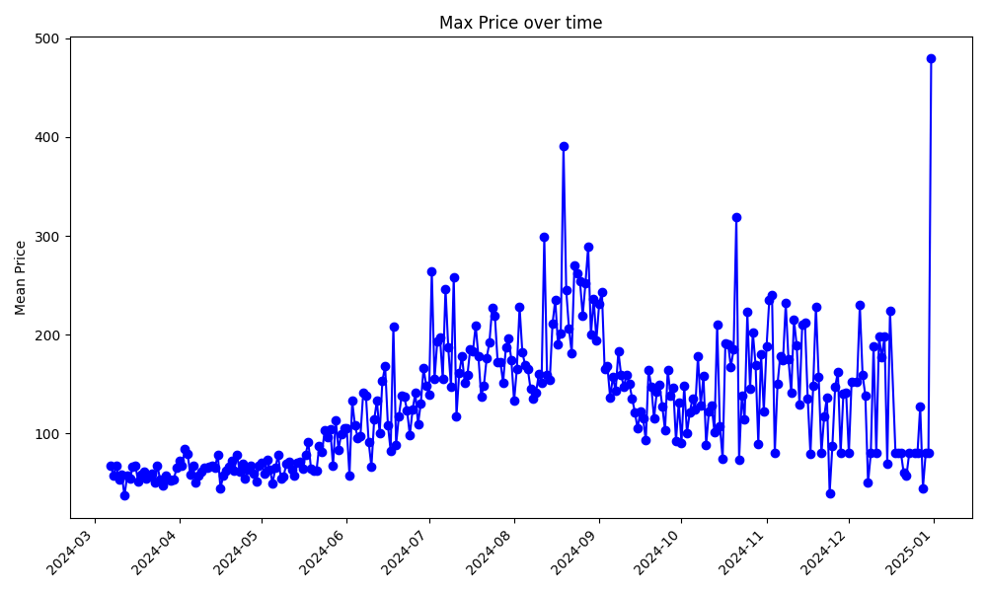
Summer
Noise
(Less Data Points)
Notes:
Toby

Slide 8
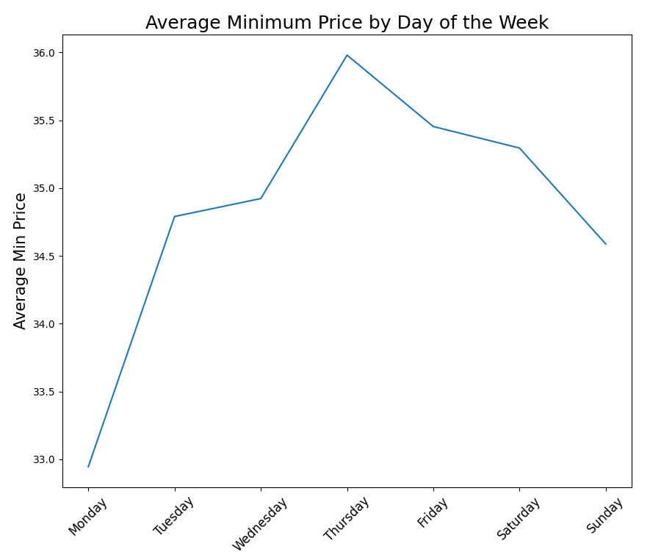
Notes:
Eva

Slide 9
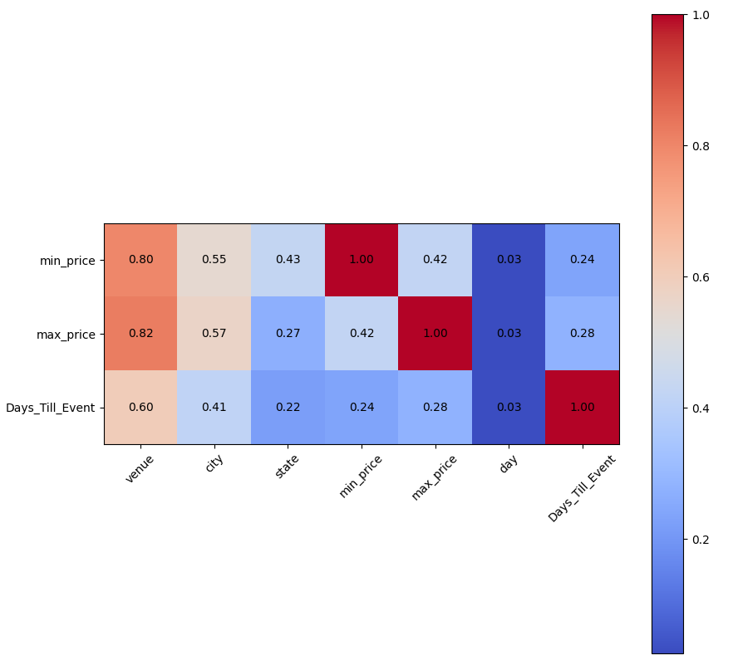
Correlation Matrix Between Price and Other Variables
Notes:
Toby

Slide 10
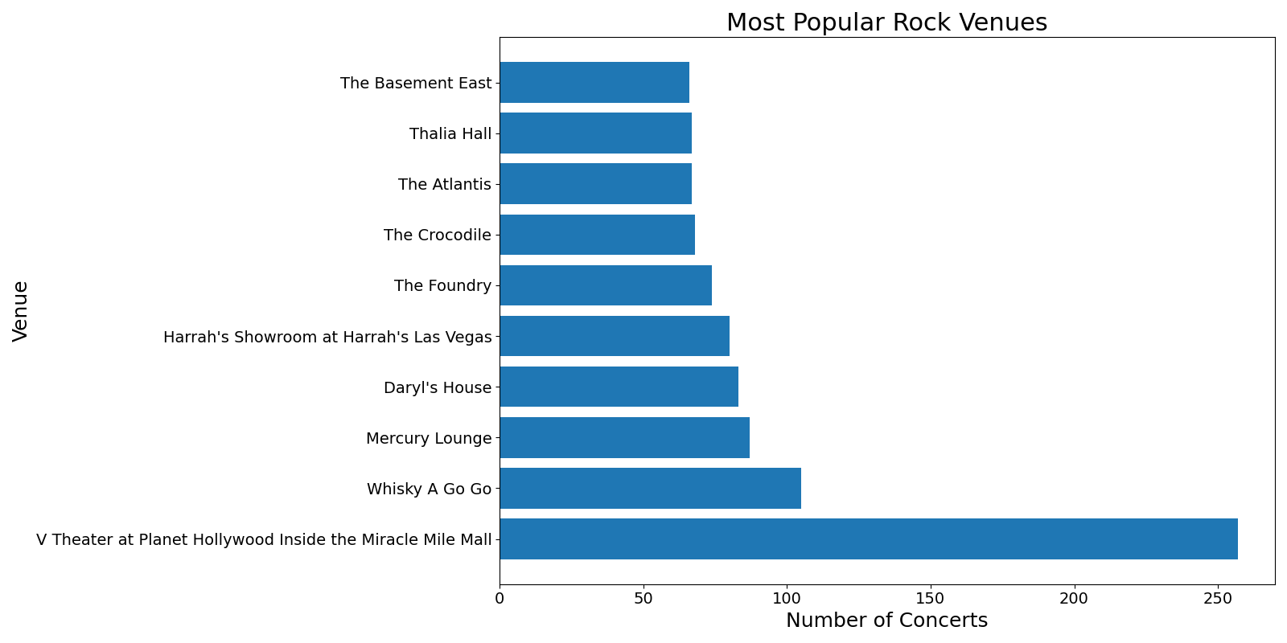

Vegas
Pawling, NY
NYC
Sunset Strip, LA
Notes:
Eva

Slide 11
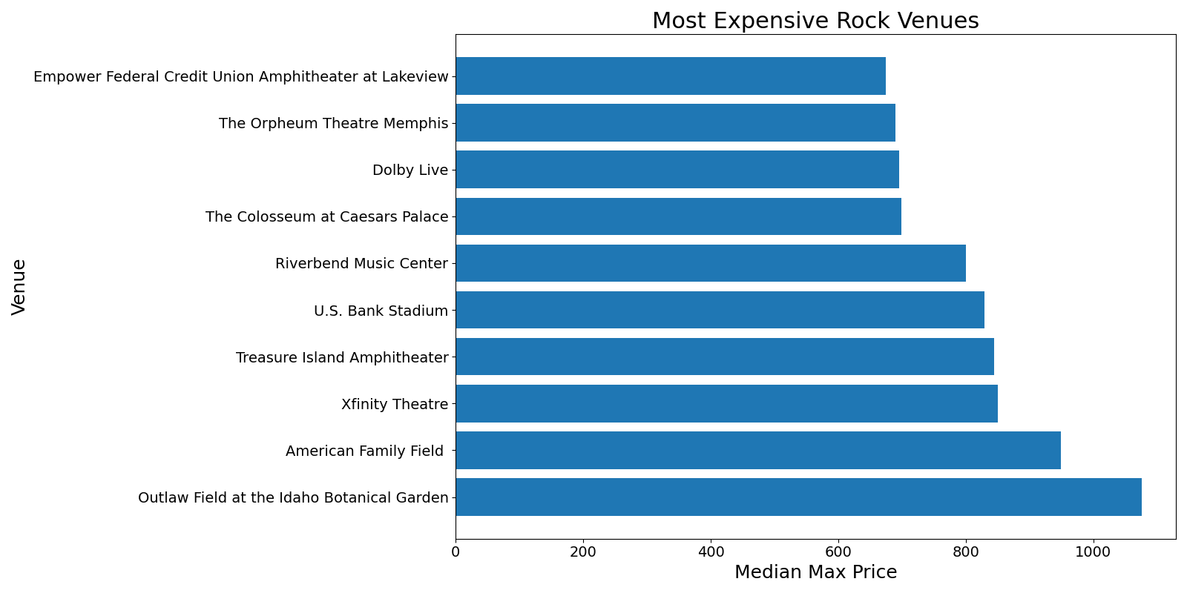
Notes:
Eva

Slide 12
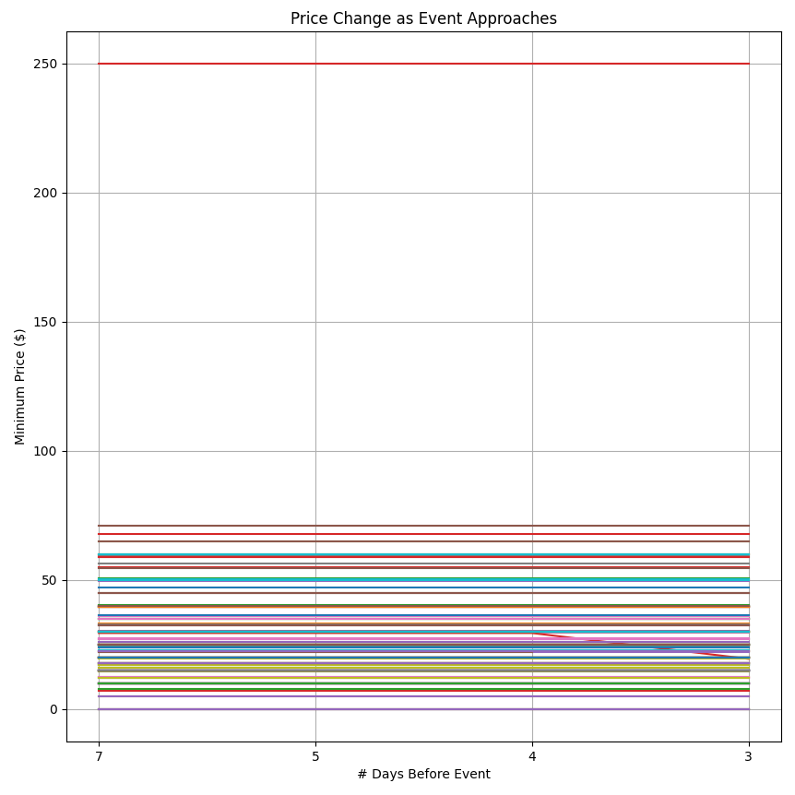
Notes:
Fernando

Slide 13
Our Conclusions
Tickets are more expensive on weekends and in the summer
The most popular venues are in Vegas, NY, and LA
The most expensive venues have special-tiered tickets
It’s challenging to investigate daily price changes
Not enough information
Notes:
Alexa

Slide 14
New Website Just Launched!
Check it out!!!
Notes:
Fernando

Slide 15
Thanks!

Slide 16
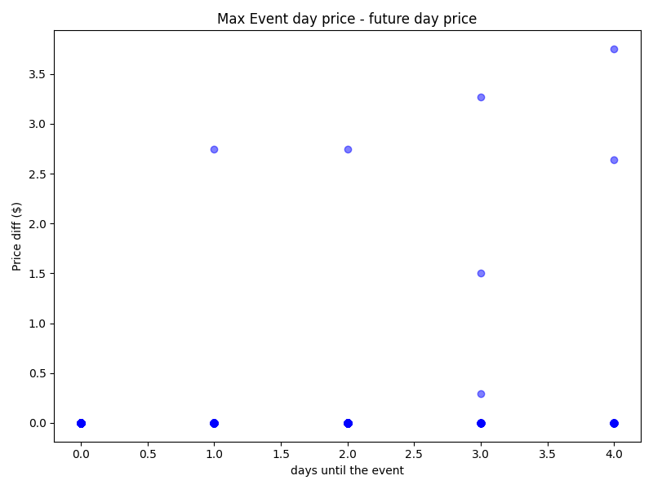
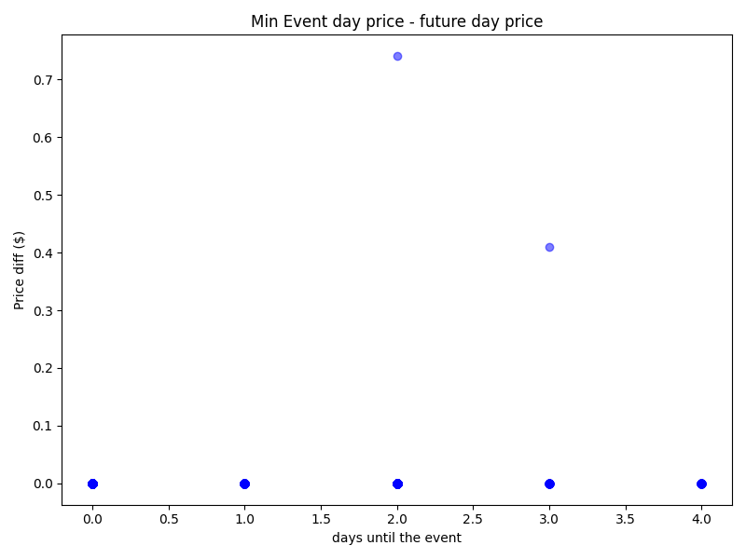
Notes:
fernando

